Slide 1


Colorado Retail Trend Forecasting

Slide 2

Goal Of the Project
Forecasting Total Revenue Sales of Colorado by developing Arima model

Slide 3

Regarding Data
Number of returns, gross sales, retail sales, state net taxable sales, retailers, and state sales tax summarized monthly by city from the Colorado Department of Revenue.
Data is from year 2016 to 2020

Slide 4
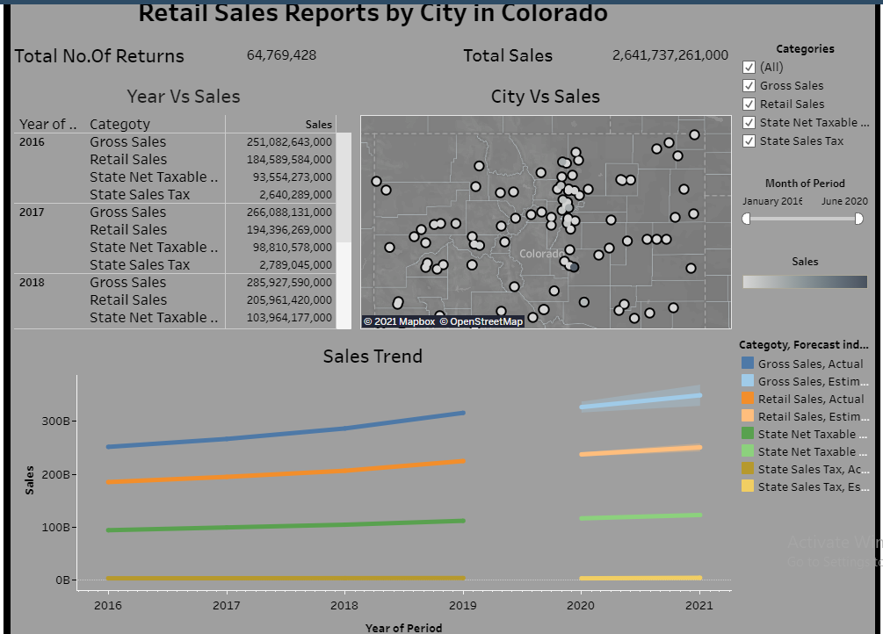
Data Analysis using Tableau

Slide 5
EDA And Data Preparation
There are few steps taken to clean the data
As for time series analysis we need a time timestamp .Here two column are there month and year. Using concatenation and changing data type to time stamp I achieved that.
Created a calculated column for Total Sales.
Taken care of data types in data frame
Replaced Null values with previous value.

Slide 6
What is Arima Model and Why I used it
And this reason is the Wold's decomposition theorem - any covariance stationary process has a linear representation: a linear deterministic component (VtVt) and a linear indeterministic components (εtεt)
An Autoregressive Integrated Moving Average or ARIMA model is a class of statistical model for analyzing and forecasting time series data. The purpose of the model is to fit the time series data as well as possible and to generate predictive power for future occurrences of the variable in question.
ARIMA might be preferred when the series are stationary. And this reason is the World's decomposition theorem - any covariance stationary process has a linear representation: a linear deterministic component (Vt) and a linear indeterministic components (εt)

Slide 7
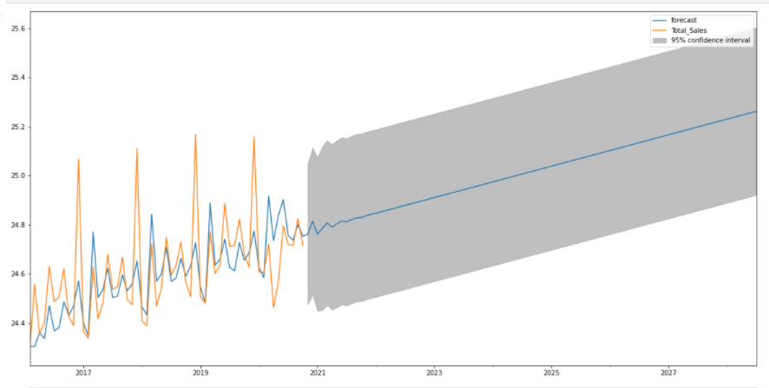
Result OF Forecasting

Slide 8
Learning from this Project
Preparation of the data is important. As model is going to be dependent on your prepared data.
We need to careful while using statistics. We need to use different methods to before making conclusion.

Slide 9

References
https://data.colorado.gov/Business/Retail-Reports-by-City-in-Colorado/2yhn-3dbj
https://machinelearningmastery.com/arima-for-time-series-forecasting-with-python/
https://sites.google.com/site/econometricsacademy/econometrics-models/time-series-arima-models

Slide 10

Thank you

